Slide 1
OPS4 in depth
Open Publish Subscribe (v4)
(Communication Middleware)

Slide 2
OPS4, Open Source
Link to GitHub
https://github.com/staxgr/ops (original, outdated)
https://github.com/LelleAnd/ops (current development)
Notes:
Repo structure?
How to build?

Slide 3
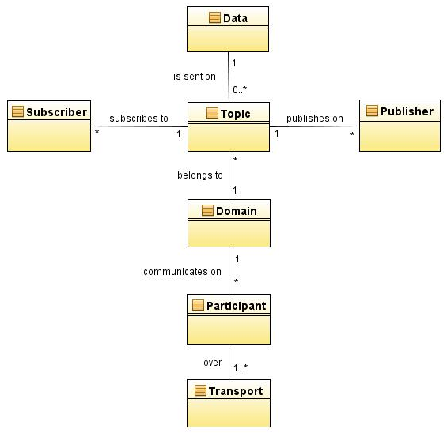
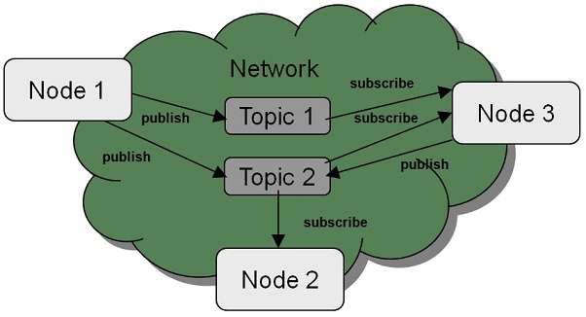
OPS4, Entities
Entities
Data Object (data type)
Topic (variable name)
Domain
Participant
Publisher
Subscriber

Slide 4
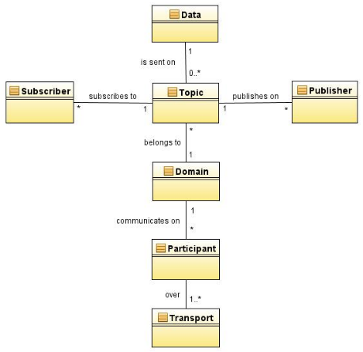
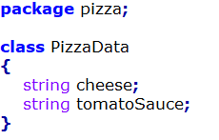
OPS4, Data Objects
Each Data Object is defined in an IDL-file
Namespace: pizza
Filename: PizzaData.idl
Data Object: PizzaData
Data members:
https://github.com/LelleAnd/ops/blob/development/Doc/IDLLanguage.md

Slide 5
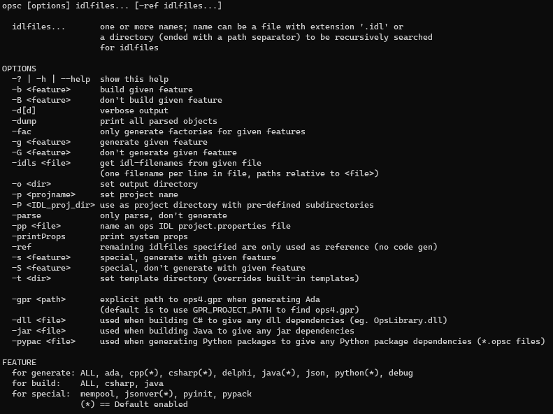
OPS4, Data Objects
opsc command-line tool
Translates IDLs to source code
Data classes
Data members
Serialization & De-serialization
Cloning
Publishers & Subscribers
Class factory
One per project
Creates data class from type name
Ada, C++, C#, Delphi, Java, Python
Can build C# dll’s and Java jar’s (Python packages currently not working)

Slide 6
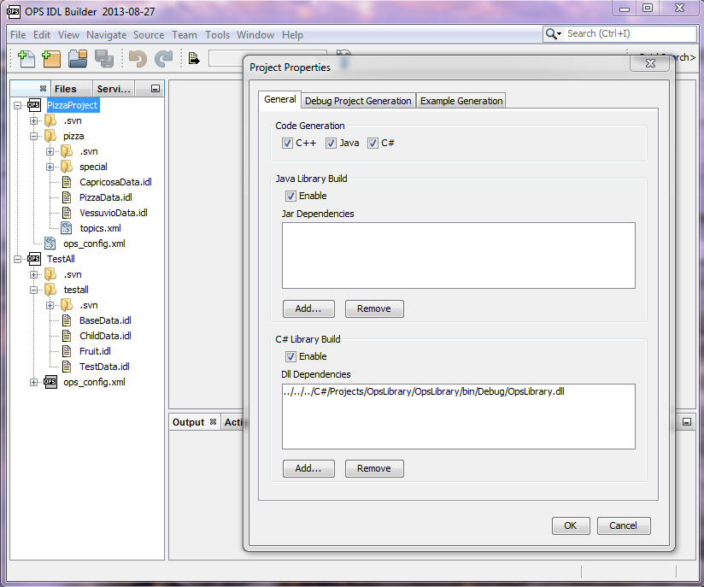
OPS4, Data Objects
OPS IDL Builder tool (outdated)
IDL-files grouped into IDL-projects
Project properties
Translates IDLs to source code
Data classes
Data members
Serialization & De-serialization
Cloning
Publishers & Subscribers
Class factory
One per project
Creates data class from type name
Can build C# dll’s and Java jar’s
Notes:
OLD, Tool need updates,
Add all languages to dialog
Python, Ada, Delphi, JSON

Slide 7
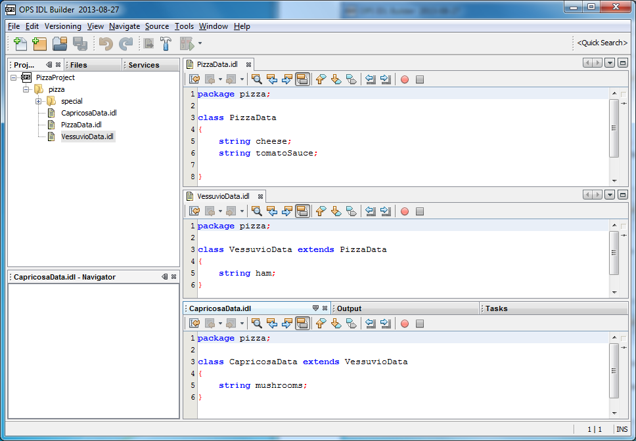
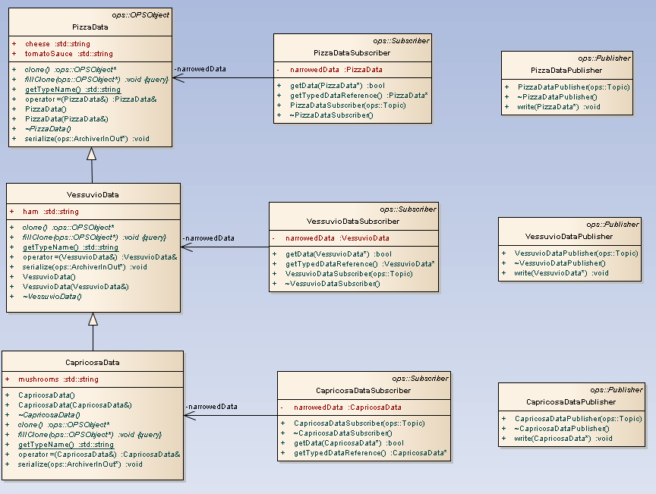
OPS4, Data Objects
Inheritance supported for Data classes
Notes:
Note that OpsObject is the base class

Slide 8
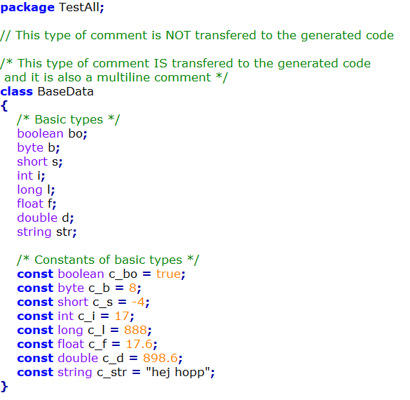
OPS4, Data Objects
Two types of comments
// →IDL-only
/* */ →Copied to generated files
Data types
Basic types
…
Constants of Basic types
Notes:
Constants (added 2019)

Slide 9
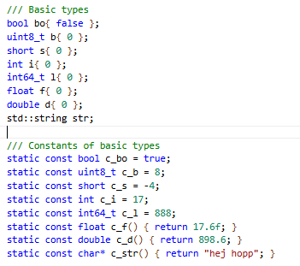
OPS4, Data Objects
Generated C++ (code snippet)
Notes:
char → uint8_t or char, can be controlled with command line argument to opsc
Default init false / 0
Can be changed by @//init directive in idl

Slide 10
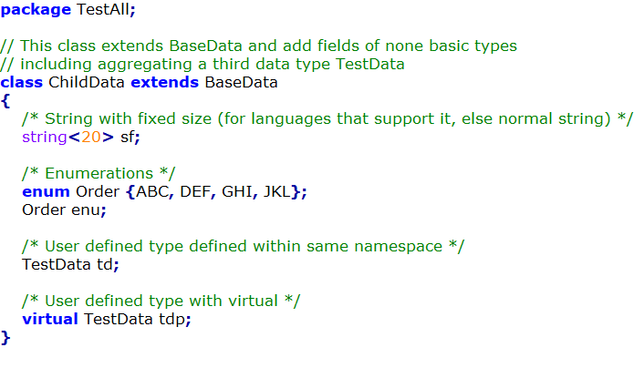
OPS4, Data Objects
Data types
Basic types
Fixed size strings
Enumerations
User defined types
”virtual” specifier
Notes:
Enumerated types (added 2019)
Virtual and non-virtual Data Objects:
Non-virtual → static object
virtual → may ref. any object that inherits from specified base object

Slide 11
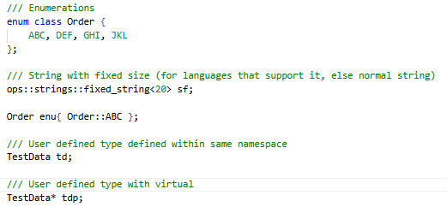
OPS4, Data Objects
Generated C++ (code snippet)
Notes:
Enumerated types (added 2019)
Virtual and non-virtual Data Objects:
Non-virtual → static object
virtual → may ref. any object that inherits from specified base object
Init:
- virtual object tdp created in constructor

Slide 12
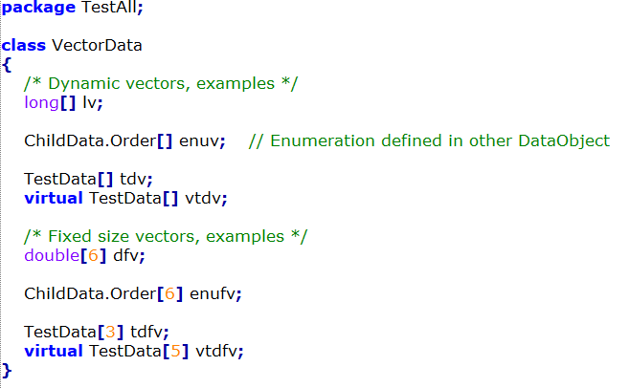
OPS4, Data Objects
Data types
Basic types
Fixed size strings
Enumerations
User defined types
”virtual” specifier
Vectors of the above types
Dynamic
Fixed sized
Notes:
Vectors with virtual can contain any object that inherits from the base object
Directives…

Slide 13
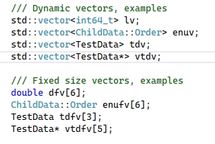
OPS4, Data Objects
Generated C++ (code snippet)
Notes:
Vectors with virtual can contain any object that inherits from the base object
Fixed size vectors initialized in constructor
Directives… (see github doc)

Slide 14
OPS4, Data Objects
IDL Compile Directives
https://github.com/LelleAnd/ops/blob/development/Doc/IDLLanguage.md
//@init
//@maxarrlen
//@maxstrlen
//@range
//@version
…

Slide 15
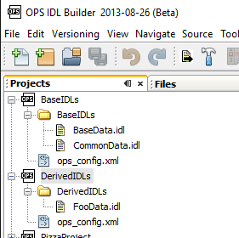
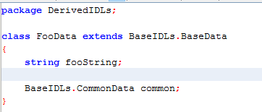
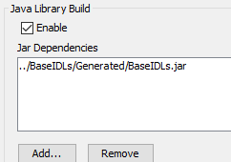
OPS4, Data Objects
Multiple IDL-projects
Notes:
Separate compilations for each project
Can use Data Objects (classes) from other projects (not enum-types)
If C#-dll, Java-jar or Python-packages should be built, the dependencies need to be provided.
One factory is generated for each compilation.

Slide 16
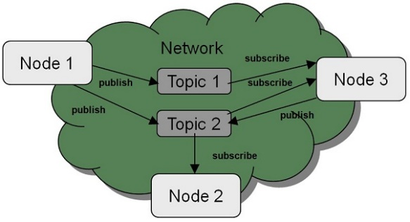
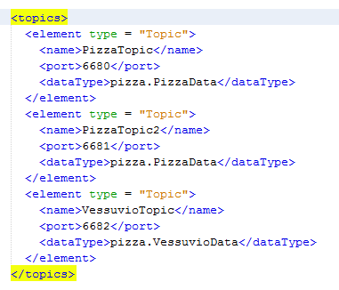
OPS4, Topic
A Topic connects a Name to a Data Object
A Topic defines some transport parameters
A Topic can be seen as a ”communication channel” for a specific Data Object
The Name of a topic is used by the user when setting up Publishers and Subscribers
Available Topics are defined in one or more configuration files
(more about configuration later)
Notes:
PORT can be configured in several different ways

Slide 17
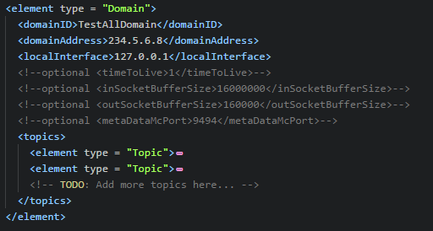
OPS4, Domain
A Domain groups a number of Topics into a logical unit
A Topic can only belong to ONE Domain
A Domain also defines some transport parameters
Domains are defined in one or more configuration files
(more about configuration later)
A Domain has a Name that is unique in its configuration file
The Name of a domain is used by the user when setting up Participants

Slide 18
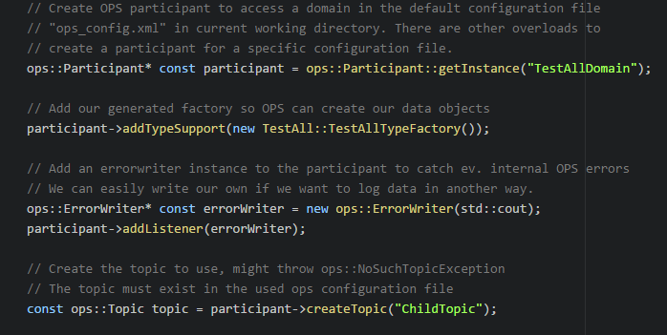
OPS4, Participant
The Participant ...
is the application manager for the communication within a Domain
owns all send and receive data handlers for communication channels (internal classes)
owns the Data Object factories
Generated class factories should be added by user code (needed for objects that are received)
is a factory for creating Topics
A Topic is needed when creating Publishers and Subscribers (Topic Name is used)
can distribute communication meta data
Available subscribers and publishers, …

Slide 19
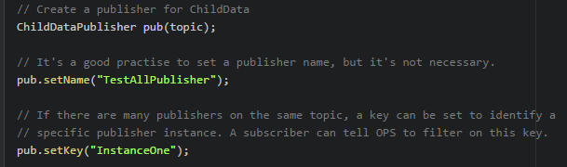
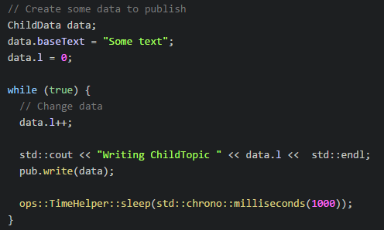
OPS4, Publisher
Publishers are generated
Topics from the Participant
Publisher Name and Key
Meta data sent to subscribers
Publishing Data
Have an instance of the Data Object
Update members in the Data Object
Call write()
Notes:
Start()
Stop()

Slide 20
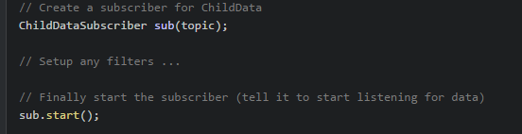
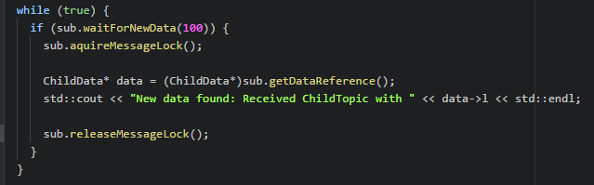
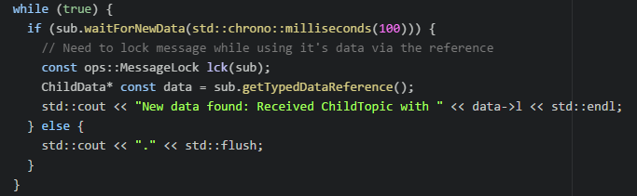
OPS4, Subscriber
Subscribers are generated
Topics from the Participant
Receive filters
Key filter
Time based filter
User defined filter on any meta data and/or member field in the Data Object
Receiving can be
Based on polling or
Event-based using callbacks
Notes:
Point out the LOCK. Without locking, data can be changed while accessing it.
Several different calls, some takes the LOCK and makes a copy.
The LOCK blocks all reception in the participant (C++) while held.
Point out the RAII helper for the LOCK (ops::MessageLock).
Polling: If messages arrive close together, they can easily be missed. Only the latest is saved in the Subscriber.
Advanced: C++ and Delphi implements a history buffer with adjutstable size, but it is difficult to use correct. Easier to use callbacks.
Ada also have some code for a history buffer, but it is not fully implemented yet.

Slide 21
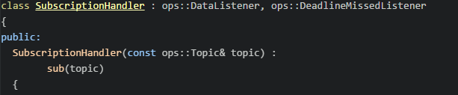
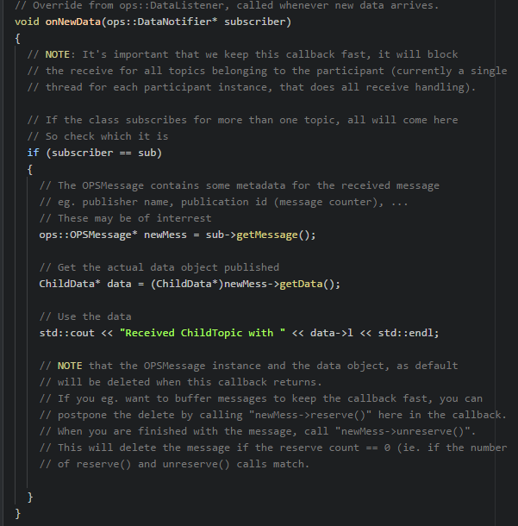
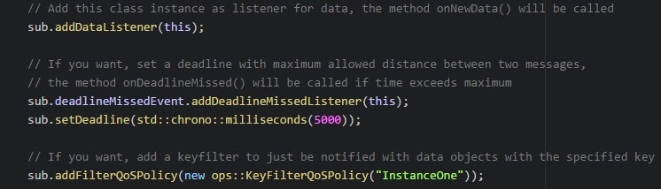
OPS4, Subscriber, Callback example
OPSMessage
Metadata
Publishername, Topicname, IP, Port, PublicationID
Metods
reserve() / unreserve()
Notes:
Point out that objects are removed as soon as the callbacken returns.
OPSMessage contra OPSObject

Slide 22
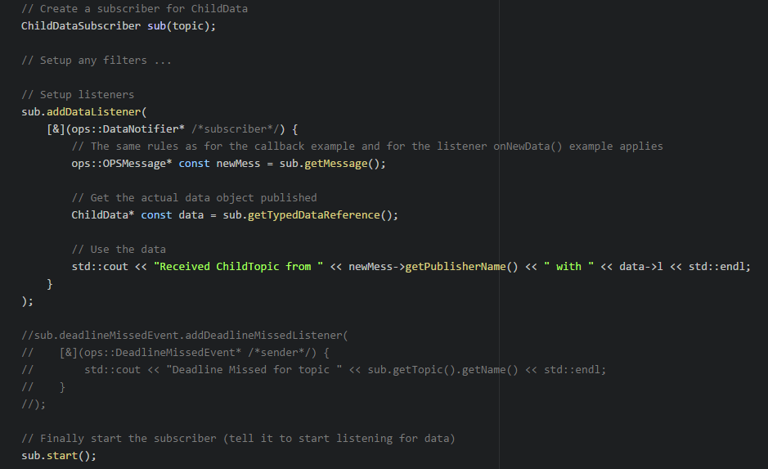
OPS4, Subscriber, Lamda example
Notes:
Point out that objects are removed as soon as the callback returns.

Slide 23
OPS4, Transport
Socket based transports
Multicast many-to-many
+ Load on publisher not affected by adding subscribers
- Based on UDP were packets can be lost (for C++, ACK and resends can be used)
- Small HW may not always support multicast
- Sent to all nodes on subnet (smart switches can be used to block, IGMP snooping)
UDP many-to-one, many-to-many
+ Only sent to configured nodes
- Packets can be lost
- Load on publisher increases for each subscriber
TCP one-to-many, many-to-many
+ Only sent to configured nodes
+ No packets are lost once link is established
- Setting up TCP-link takes some time
- Load on publisher (server) increases for each subscriber (client)
- Slowest subscriber will limit the publishing rate (when buffers are filled)
Notes:
UDP/TCP many-to-many requires metadata to be used
Metadata always use multicast

Slide 24
OPS4, Transport
Non-socket based transports
Shared-memory one-to-many, many-to-many
+ Can be faster than socket-based transport
- Only within one node (as localhost)
- Currently only for C++ on OS:s with boost-libraries
In-Process
Only within a program
Useful for writing unittests (no network delay)
Notes:
UDP/TCP many-to-many requires metadata to be used
Metadata always use multicast

Slide 25
OPS4, Participant
Receive data handler implementation details
C++
One common thread for all communication channels (sockets) in a participant
The thread reads all sockets, de-serializes data, creates the objects and gives them to the subscribers
To improve receive performance (i.e. use more CPU cores), use several participants and topics on different ports
C#, Java, Delphi, Ada and Python
One unique thread for each communication channel (socket)
Each thread reads a socket, de-serializes data, creates the objects and gives them to the subscribers
To improve receive performance (i.e. use more CPU cores), use topics on different ports
Notes:
Can use multiple participants

Slide 26
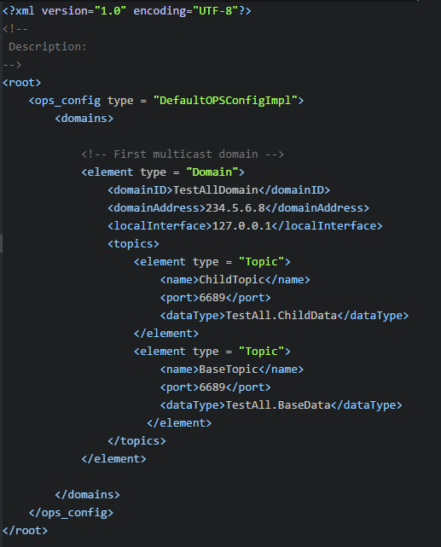
OPS4, Configuration (minimal)
XML-file with one or more Domains, each with one or more Topics
Domain parameters
domainID
domainAddress
Multicast address (224.x.x.x – 239.x.x.x)
localInterface
E.g. 127.0.0.1, 192.168.10.0/24, …
List of Topics
name
Must be unique within Domain
dataType
port
Notes:
Minimal configuration
Add something about OpsConfigRepository, to make it easier to use multiple config-files (currently missing for Python)

Slide 27
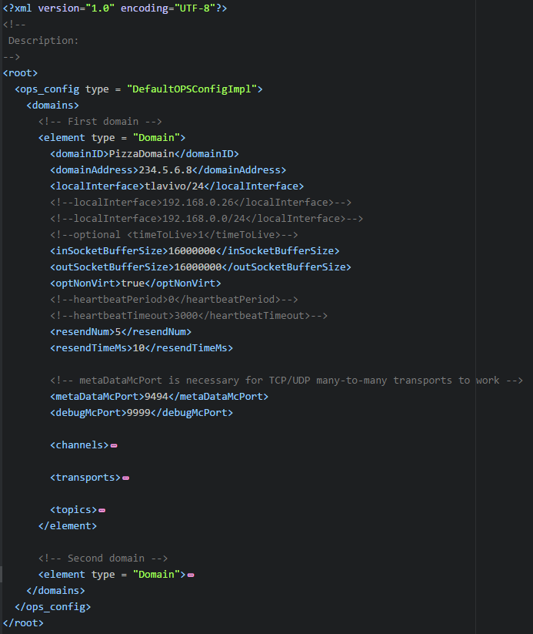
OPS4, Configuration (full)
Domains
Parameters
See repo doc
Channels
Transports
Topics
https://github.com/LelleAnd/ops/blob/development/Doc/OpsConfig.md
Notes:
Different ports, same ports
Socket buffers

Slide 28
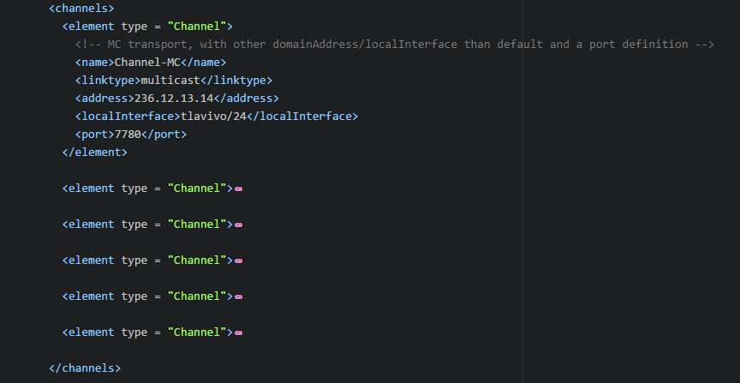
OPS4, Configuration (full)
Domains
Parameters
Channels
Parameters
See repo doc
Transports
Topics
https://github.com/LelleAnd/ops/blob/development/Doc/OpsConfig.md
Notes:
Different ports, same ports
Socket buffers

Slide 29
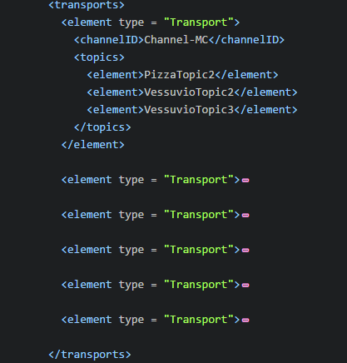
OPS4, Configuration (full)
Domains
Parameters
Channels
Transports
Parameters
See repo doc
Topics
https://github.com/LelleAnd/ops/blob/development/Doc/OpsConfig.md
Notes:
Different ports, same ports
Socket buffers

Slide 30
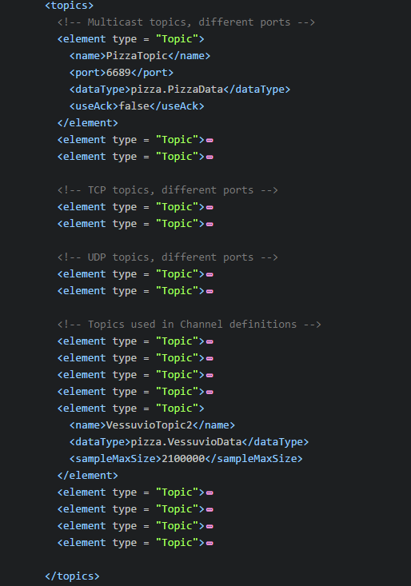
OPS4, Configuration (full)
Domains
Parameters
Channels
Transports
Topics
Parameters
See repo doc
https://github.com/LelleAnd/ops/blob/development/Doc/OpsConfig.md
Notes:
Different ports, same ports
Socket buffers

Slide 31
OPS4, Large Data Objects
Large data objects (> 60000 bytes)
Only one publisher
Topic must have a unique communication channel (socket port, shared memory)
https://github.com/LelleAnd/ops/blob/development/Doc/LargeMessages.md
Drawbacks with large objects
Multicast & UDP transports
One lost Ethernet packet, loses the whole Data Object
→ important to have good HW and enough memory for Ethernet buffers
41
Ethernet
Packets
Data Object
UDP Packets
60000
1472
…
60000
…
1472
60000
1120
Notes:
DISCUSSION: Large data on same or separate topics
Jumbo packets

Slide 32
OPS4, Memory Management
Memory management
Ref. counting
OPSMessage methods reserve() / unreserve()
https://github.com/LelleAnd/ops/blob/development/Doc/AdvancedReferenceHandling.md
…
Notes:
OPSMessage

Slide 33
OPS4, Version Handling
Using Data Object inheritance for version handling…
A change to an existing Data Object results in a need for total rebuild of all programs depending on it or failures will occur when mixing old an new.
Instead one can,
create a new Data Object that inherits from the old Data Object,
add the new fields to the new object,
update the publisher that have the new parameters, but it must still also provide the old values,
update the subscriber(s) that need the new parameters,
all other publishers and subscribers can be left as is.
See repo doc for other alternatives https://github.com/LelleAnd/ops/blob/development/Doc/VersionHandling.md

Slide 34
OPS4, Binary Protocol
See repo doc https://github.com/LelleAnd/ops/blob/development/Doc/Protocol.md

Slide 35
OPS4, Tools
Network
Network
Node
Node
OPS Bridge
OPS Bridge
Node
Node
OPSBridge
https://github.com/LelleAnd/ops/blob/development/Doc/OPSBridge.md
DebugConsole
https://github.com/LelleAnd/ops/blob/development/Doc/DebugConsole.md
OPSListener
https://github.com/LelleAnd/ops/blob/development/Doc/OPSListener.md
VerifyOPSConfig
https://github.com/LelleAnd/ops/blob/development/Doc/VerifyOPSConfig.md
Node
Node

Slide 36
OPS4 Artifact usage
Idl grammar spec
javacc
Generated Java code
Idl
definitions
Hand
Coded Java
javac
opsc
Application
Idl
definitions
Generated
Language
specific
code
Application
code
Languages:
Ada, C++, C#, Delphi, Java, Python
(JSON)
OPS
Language
specific
code
Lang.
Compiler
Executable

Slide 37
OPS4 Architecture (Internals)
Description based on C++ impl.
Roughly the same architecture in all languages:
Ada, C++, C#, Delphi, Java, Python
Participant
OPSObjects
Publisher
Subscriber
Archivers
SDH Factory
RDH Factory
SDHs
RDHs
RDCs
Senders
Receivers
Misc
Notes:
Factories ?

Slide 38
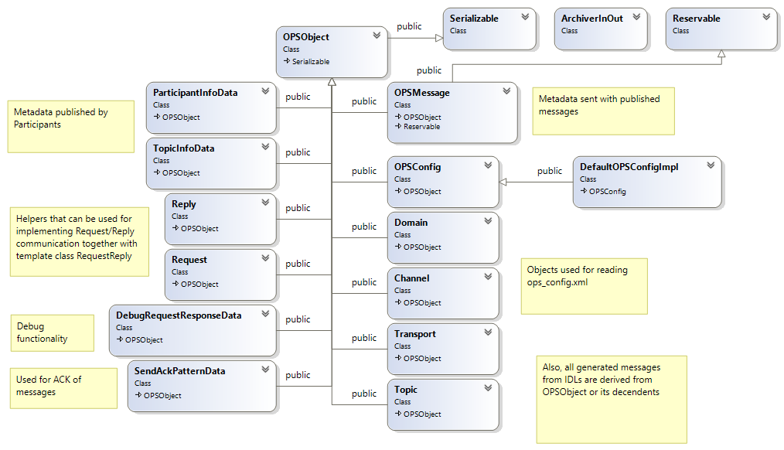
OPSObjects
OPS OPSObjects
Serialize/Archivers
OPSMessage/Reservable
Publishers sends OPSMessage with attached user data
Generated user IDLs
Notes:
OPS internal OPSObjects
Method Serialize() and Archivers
OPSMessage and Reservable
Publisher always sends an OPSMessage with its ’data’ field being the actual data from the user

Slide 39
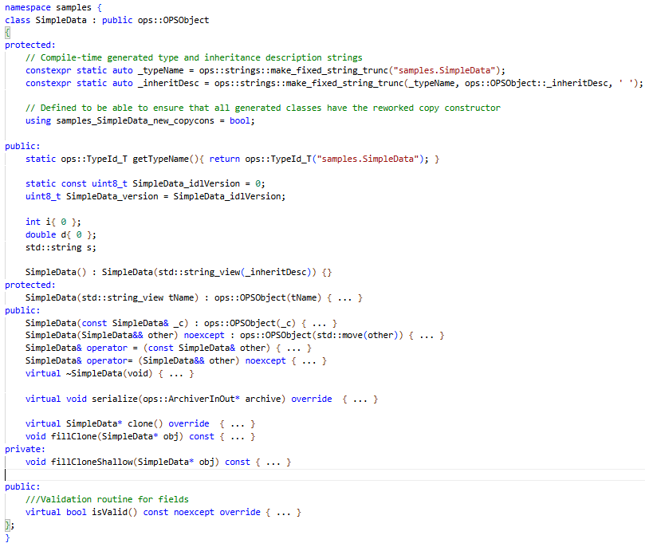
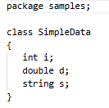
Example generated C++ data class
TypeName
Inheritance descr. string
Version fields
Idl fields
Cons/Assign/Dest
Serialize
Cloning
Validation
Notes:
Example idl --> C++
TypeName
Inheritance string (C++17 and later created at compile time)
Version fields
Constructors/Assignment/Destructor
Serialize
Cloning
Validation

Slide 40
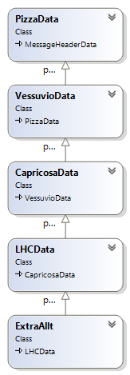
TypeName and Inheritance descr., example
pizza.PizzaData
pizza.VessuvioData
pizza.CapricosaData
pizza.special.LHCData
pizza.special.ExtraAllt
pizza.PizzaData sds.MessageHeaderData
pizza.VessuvioData pizza.PizzaData sds.MessageHeaderData
pizza.CapricosaData pizza.VessuvioData pizza.PizzaData sds.MessageHeaderData
pizza.special.LHCData pizza.CapricosaData pizza.VessuvioData pizza.PizzaData sds.MessageHeaderData
pizza.special.ExtraAllt pizza.special.LHCData pizza.CapricosaData pizza.VessuvioData pizza.PizzaData sds.MessageHeaderData

Slide 41
Example generated C++ data class
TypeName
Inheritance descr. string
Version fields
Idl fields
Cons/Assign/Dest
Serialize
Cloning
Validation
Notes:
Example idl --> C++
TypeName
Inheritance string (C++17 and later created at compile time)
Version fields
Constructors/Assignment/Destructor
Serialize
Cloning
Validation

Slide 42
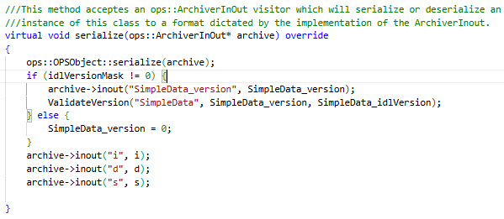
Example generated C++ data class, serialize()
Serialize/Deserialize depending on archiver
Archivers a lot of inout() methods for different types
Notes:
Serialize or deserialize depending on given archiver
Archivers have a lot of inout() methods for different types

Slide 43
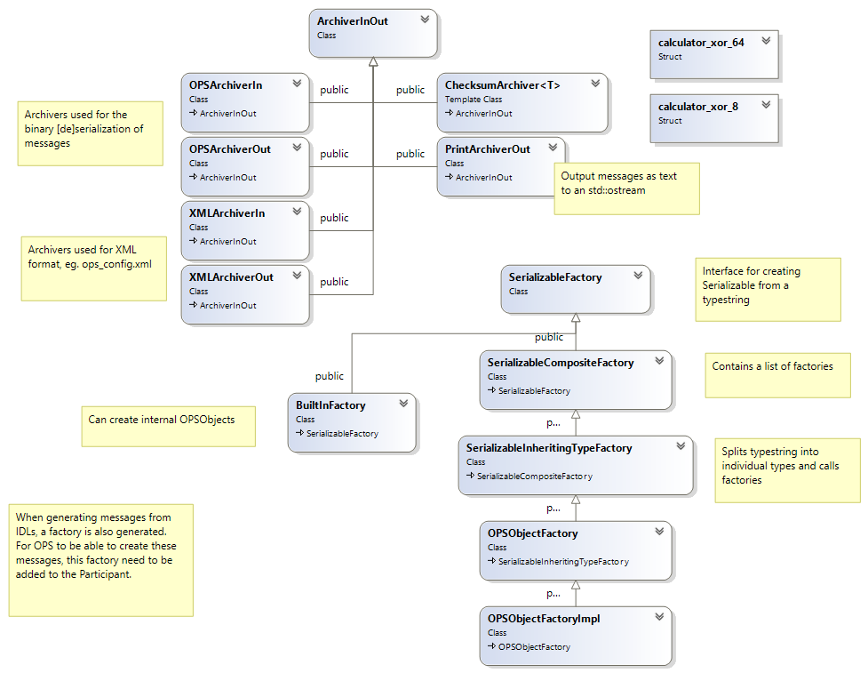
Archivers and OPSObject factories
OPS Archivers
Used as argument to serialize() method on OPSObjects
Archivers of in-type need a factory to create objects
Generated user factories
Notes:
Different Archivers
Can be used as argument to Serialize() method on OPSObjects
OPSArchiverIn/Out used internally for send/receive (binary format)
Archivers of In-type need a factory to be able to create objects

Slide 44
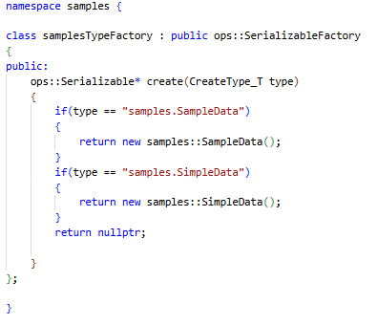
Example generated C++ factory
Generated factory should be added to Participant

Slide 45
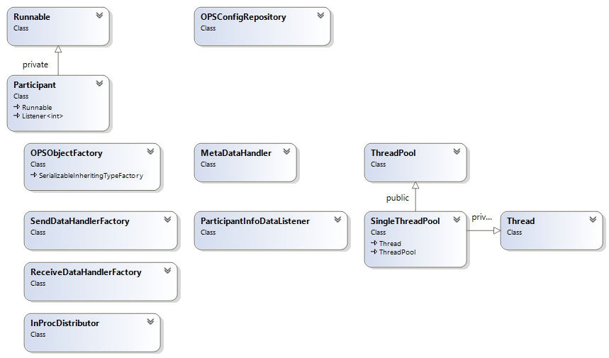
Participant
Singleton OPSConfigRepository
Participant:.getInstance(…)
Runnable, Threading/Polling
Factories, InProcDistributor
Metadata, Pub/Sub
Notes:
Singleton: OPSConfigRepository, ops_config.xml
Partcipant::getInstance( domainID [, PartID [, configfile]] [, execution_policy])
Runnable, Thread / Polling
Multiple Participants
OPSObjectFactory
SDHFactory
RDHFactory
InProcessDistributor
Metadata pub/sub
IOService (IOContext)

Slide 46
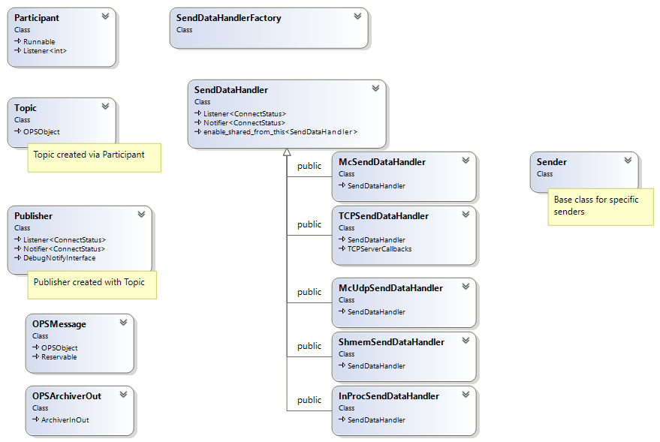
Publisher, SDHs and SDH Factory
User creates
Participant
Topic via Participant
Publisher with Topic
Publisher gets SendDataHandler via Participant
Publisher write()
OPSMessage with updated metadata
Serializes message using archiver to internal buffer
Sends buffer via SendDataHandler
Notes:
User creates Participant
User creates Topic via Participant
User creates Publisher with Topic
Publisher fetches SendDataHandler for the Topic via Participant and its SDH Factory
Publisher has an OPSMessage, with updated metadata
Serializes message using OPSArchiverOut to buffer
Sends buffer via SendDataHandler
ACK for multicast later

Slide 47
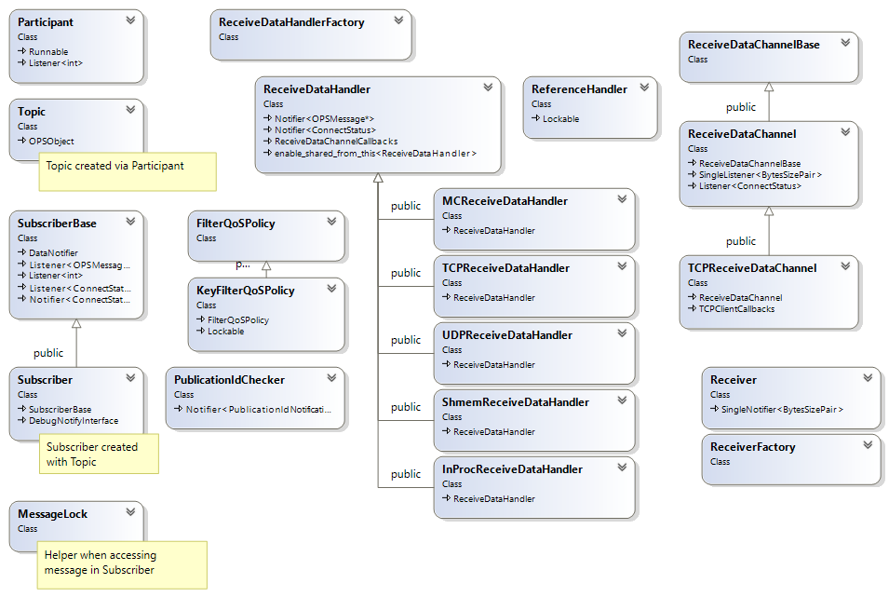
Subscriber, RDHs and RDH Factory
User creates
Participant
Topic via Participant
Subscriber with Topic
Subscriber gets ReceiveDataHandler via Participant
ReceiveDataChannel
Receive bytes to internal buffer
Deserialize buffer via Archiver
ReferenceHandler
FilterQoSPolicy
PublicationIdChecker
Deadlines
MessageLock
Notes:
User creates Participant
User creates Topic via Participant
User creates Subscriber with Topic
Subscriber fetches ReceiveDataHandler for the Topic via Participant and its RDH Factory
ReferenceHandler

Slide 48
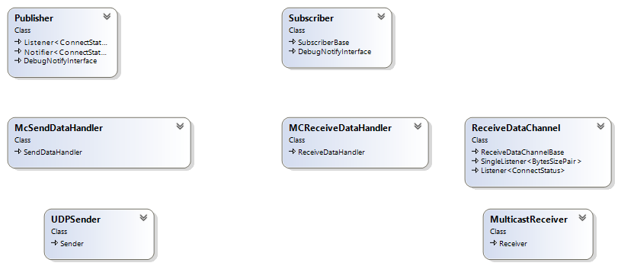
Multicast transport
Featurelist
Many-2-Many transport
Port specified in ops_config
(Publisher) SDH writes data to port
When ACKs enabled
Publisher starts a Subscriber for ACKs
Subscriber starts a Publisher for ACKs
ACK Topic is automatic (#ack)
Register/Unregister for ACKs
Resends serialized data if ACK missing
Callback to User if no ACK within x sends
Notes:
Many-2-Many
ACK case

Slide 49
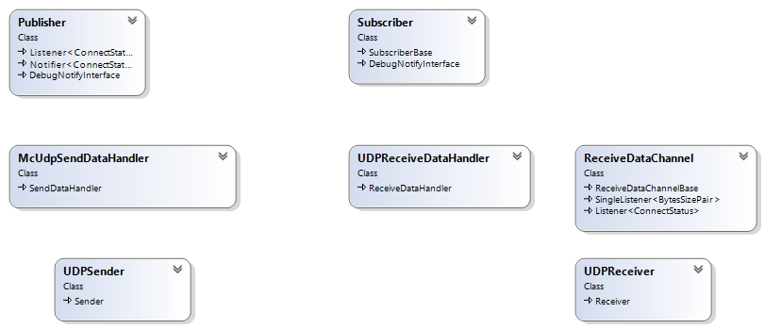
UDP transport
Featurelist
Many-2-One transport
Subscriber port specified in ops_config
(Publisher) SDH writes data to port
Many-2-Many transport
No port specified in ops_config
Subscriber uses dynamic port from OS
Port published by Participant metadata
SDH gets destination ports from MetaDataHandler as they become available
(Publisher) SDH writes data to all ports
SDH removes destination ports as they become non-alive
Notes:
Many-2-One
Many-2-Many

Slide 50
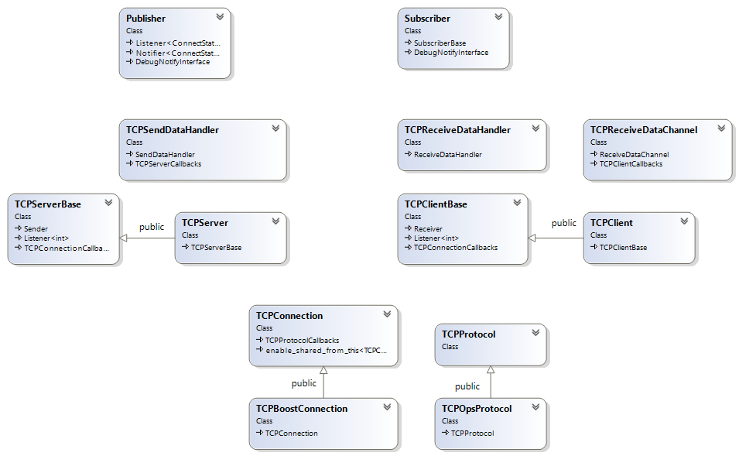
TCP transport
Featurelist
One-2-Many transport
Publisher port specified in ops_config
Publisher is a TCPServer
Server, list with connected clients
(Publisher) TCPServer writes data to all connected clients
Many-2-Many transport
No port specified in ops_config
Publisher uses dynamic port from OS
Port published by Participant metadata
RDH gets server ports from MetaDataHandler as they become available and creates RDCs
Protocol versions v1/2
Heartbeats, …
Notes:
One-2-Many
Many-2-Many
TCP protocol versions 1 and 2
Heartbeats

Slide 51
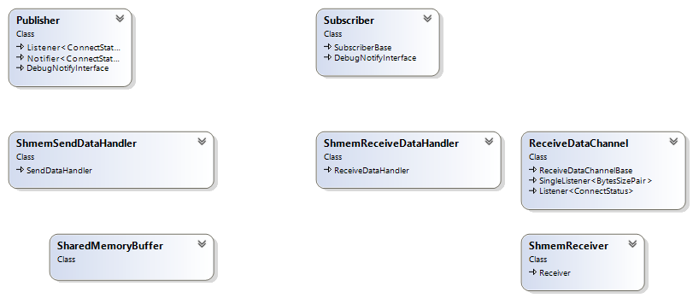
Shared Memory transport
Featurelist
One-2-Many transport
When metadata not used
(Publisher) SDH writes data to a circular buffer in shared memory
Receivers have a thread waiting for unread data
Many-2-Many transport
When metadata is used
Shared memory name published by Participant metadata
RDH gets name from MetaDataHandler as they become available and creates RDCs
(Publisher) SDH writes data to a circular buffer in shared memory
Receivers have a thread waiting for unread data
Notes:
One-2-Many
Many-2-Many

Slide 52
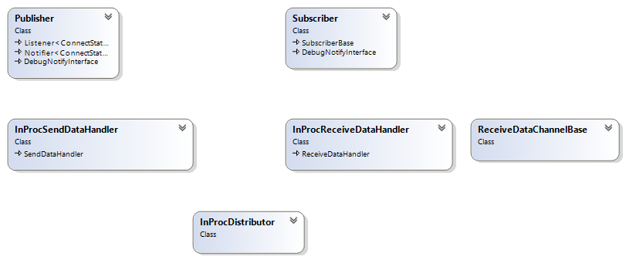
In-process transport
Featurelist
Many-2-Many transport
No [de]serialization
Message sent as is (cloned)
Notes:
No [de]serialization
Message sent as is (cloned)

